Slide 1
Comp 2610/6261
Tutorial 5 : Inequality & Typical Sets & AEP

Slide 2




Markov’s Inequality
Chebyshev’s Inequality

Slide 3
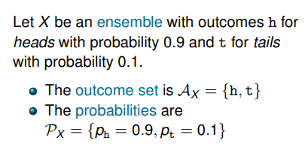
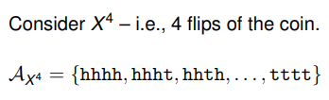
Ensembles

Slide 4
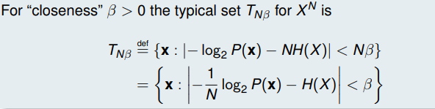
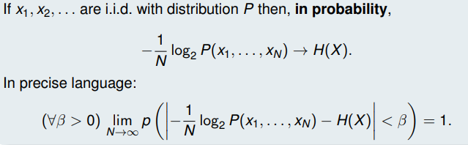
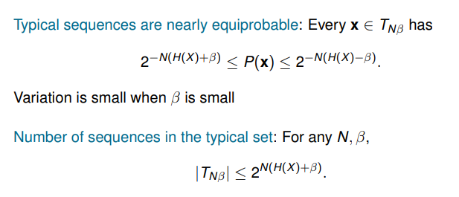
Typical Sets
Asymptotic Equipartition Property (AEP)

